Slide 1
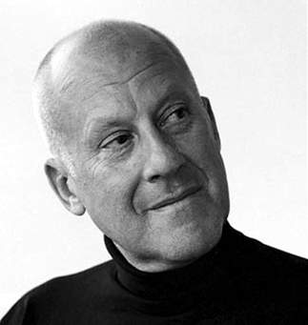
LORD NORMAN FOSTER

Slide 2
“Everything inspired me At times I can see things that others can’t see”

Slide 3
“ My mission is to create a structure that is sensitive to the culture and climate of its place..”

Slide 4
INTRODUCTION
Norman foster was born in Manchester, England in 1935. his father was a shop manager in a poor area of Manchester, later a security guard and a manual worker in a factory. his parents sent him to a private school and grammar school.

Slide 5
there was a strong work ethic and pressure to leave school early and be a wage earner and foster worked for two years in the city treasurer's office, studied commercial law, before leaving for national service in the royal air force.
at this time he was developing a growing interest

Slide 6
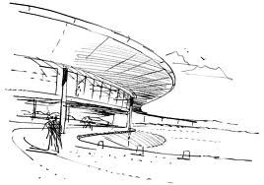
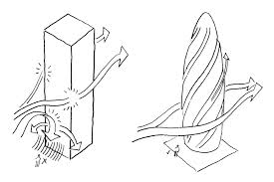
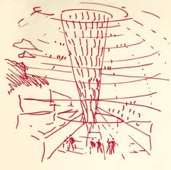
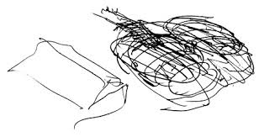
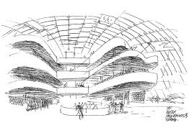
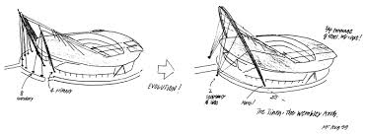

Slide 7
DESIGN ELEMENTS
STENGTH OF SIZE
CURVED LINES
OPEN PLANNED
USE OF CURVED LINE
WIDE RANGE OF BUILDING MATERIALS
ATTENTION TO DETAILS

Slide 8
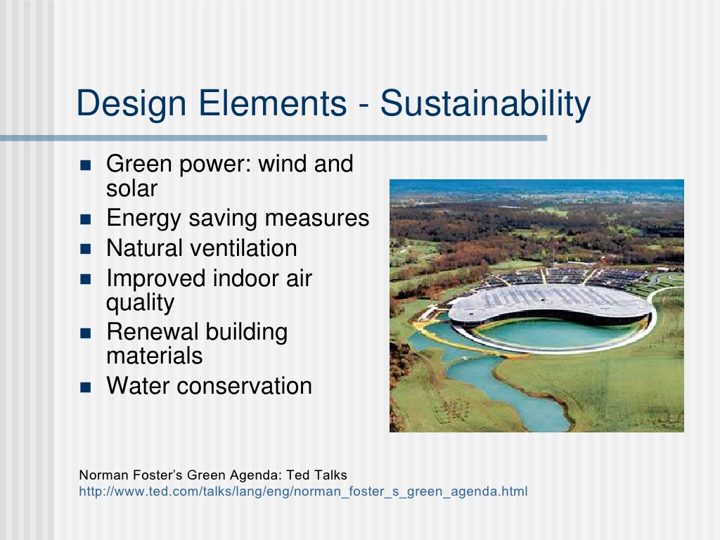

Slide 9
INFLUENCE
He had always been a model student and his skills showed a remarkable flair for architecture.
But he still always came under the influence of architects Frank Lloyd Wright and Le Corbusier.

Slide 10
TEAM FOSTER
After his return from America, Norman Foster started a partnership with Richard Rogers and sisters Georgie and Wendy Cheesman, called Team 4.
They quickly gained a reputation for industrial design high-tech. In 1967, he formed with Wendy the office Fosters Associates which quickly transformed into Fosters and Partners.
A year later he began a long partnership with the American architect Richard Buckminster Fuller, which only ended with the death of Fuller in 1983.

Slide 11
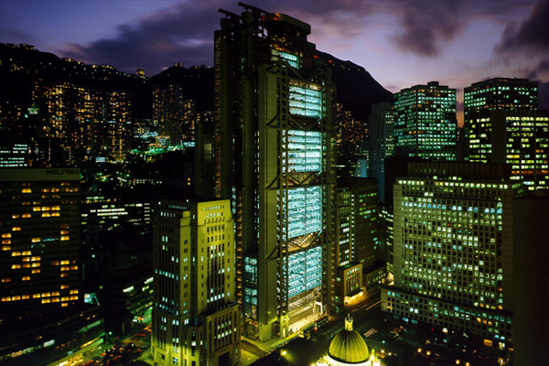
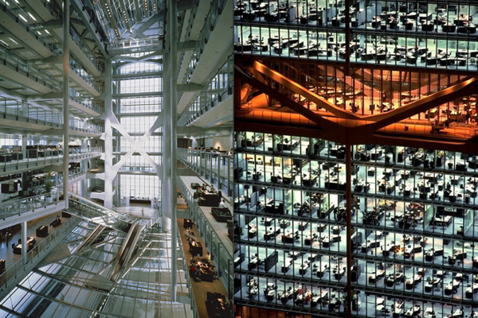
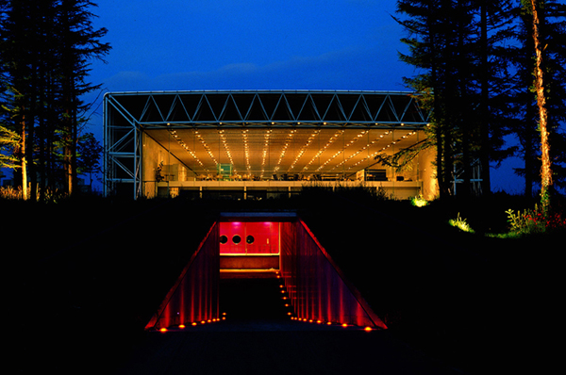
Sainsbury Centre for Visual Arts, Norwich,
Hong Kong and Shangai Bank Headquarters, Hong Kong, China

Slide 12
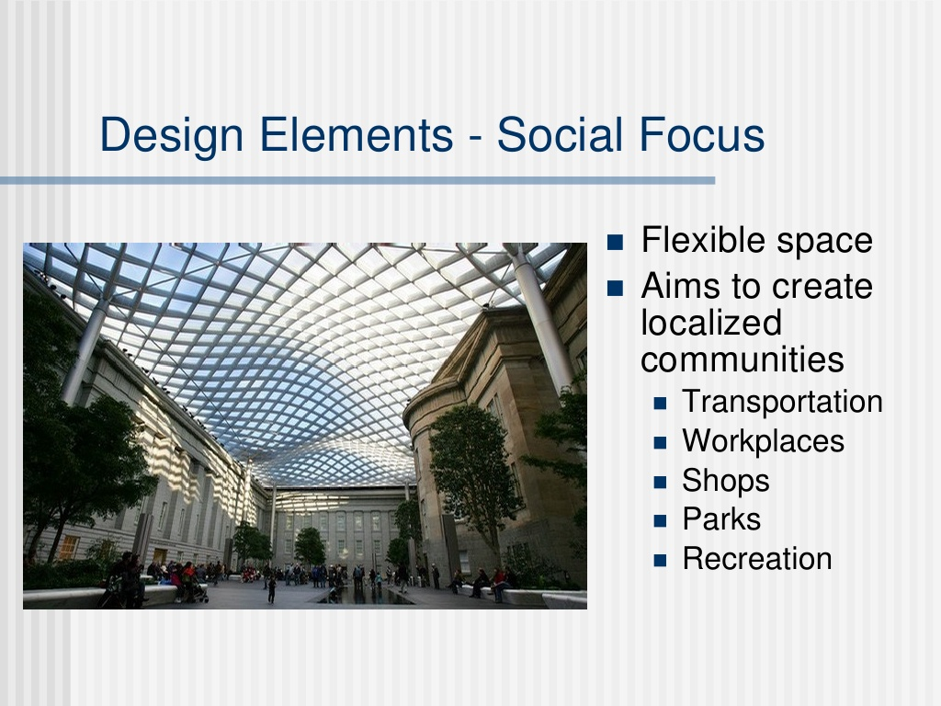

Slide 14
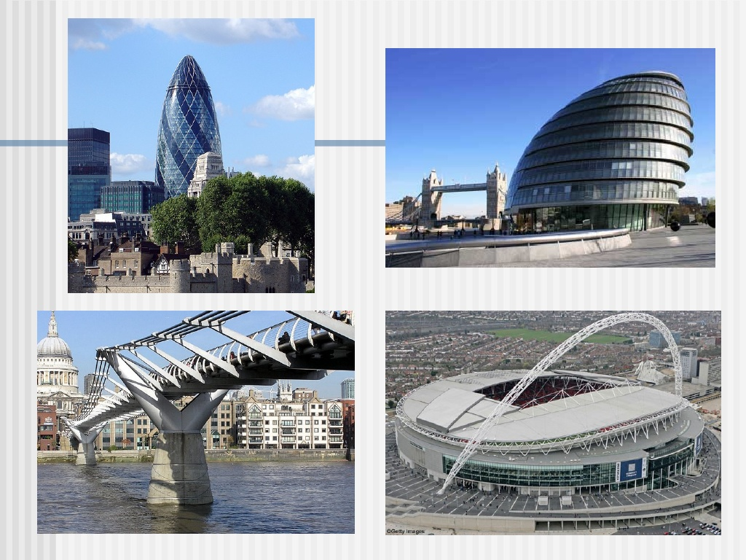

Slide 15
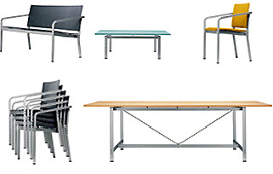
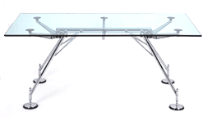
PRODUCT DESIGN

Slide 16
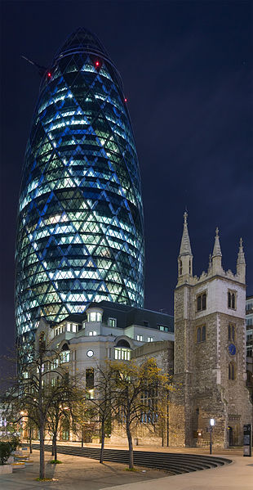
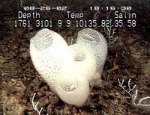
GHERKIN TOWER
Sir Norman Foster’s Gherkin Tower is a very well known building on its own, but many fail to realize its famous hexagonal skin was inspired by the Venus Flower Basket Sponge.

